Slide 1

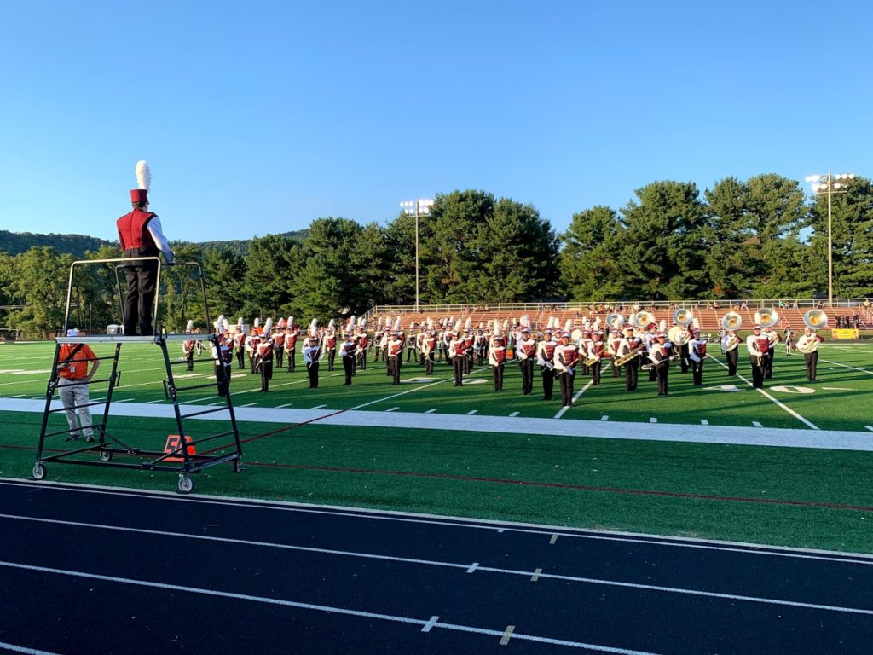

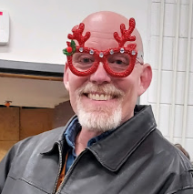
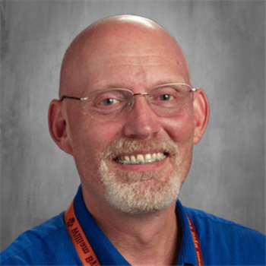
New Parent
Meeting
Band
Boosters
Dan Plybon
Director

Slide 2
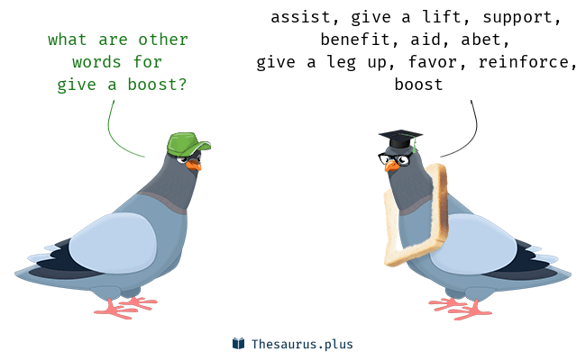
Welcome!
If you have a student in the band – Congratulations, you’re a band booster!
Fundraising
Equipment Transport
Set/Prop Building
Event Planning
Concession Sales
Ticket Sales
Uniform Management
Communications
Drill Support
Bus/Truck Rental & Driving
Chaperoning
Procurement
Marketing
Moral Support
& Loads More!

Slide 3
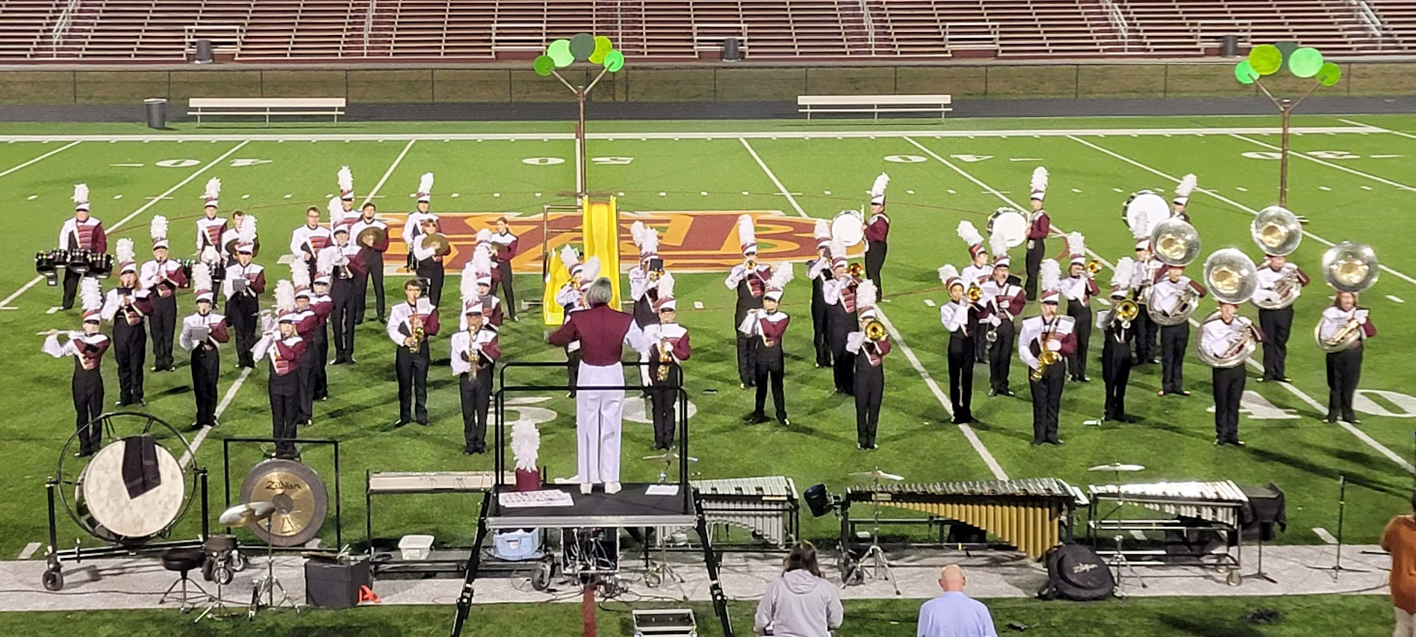
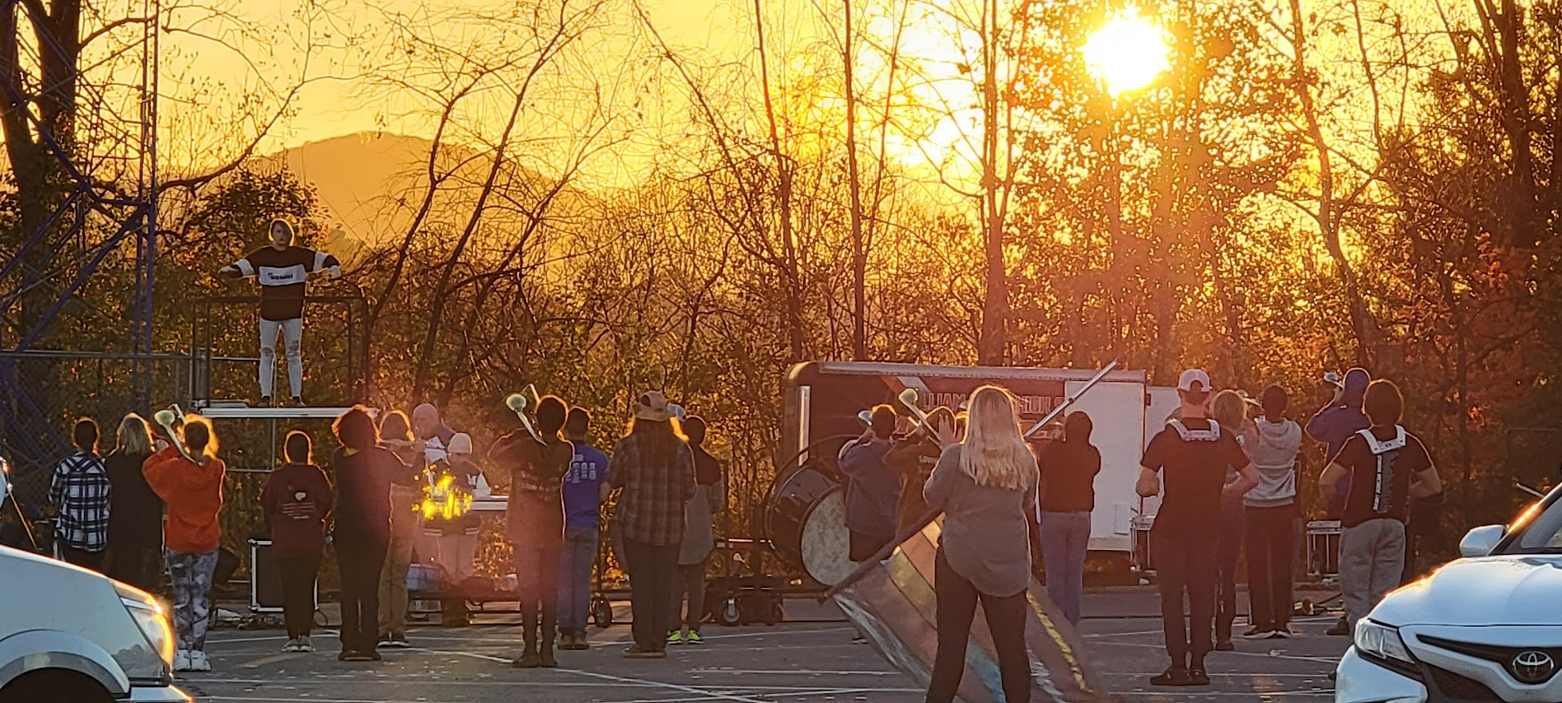
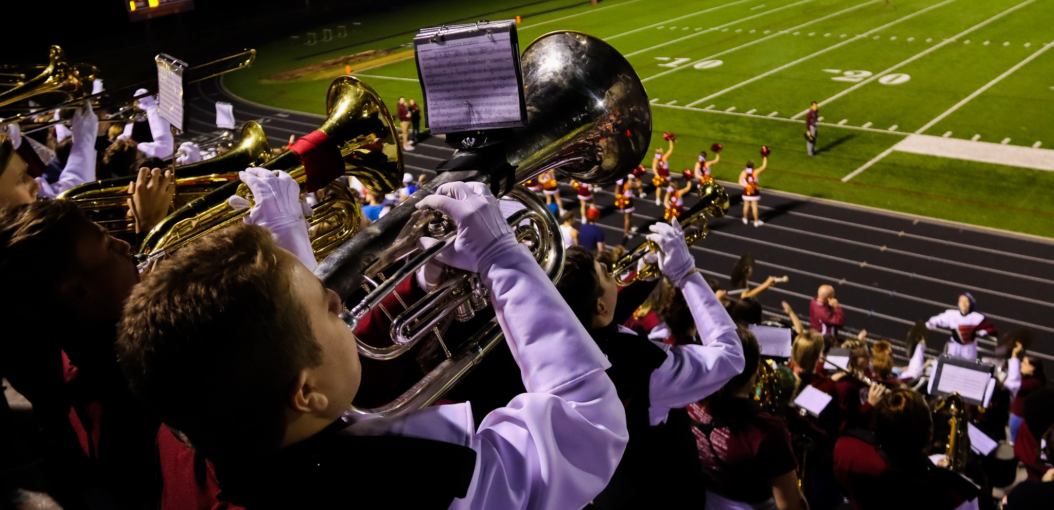
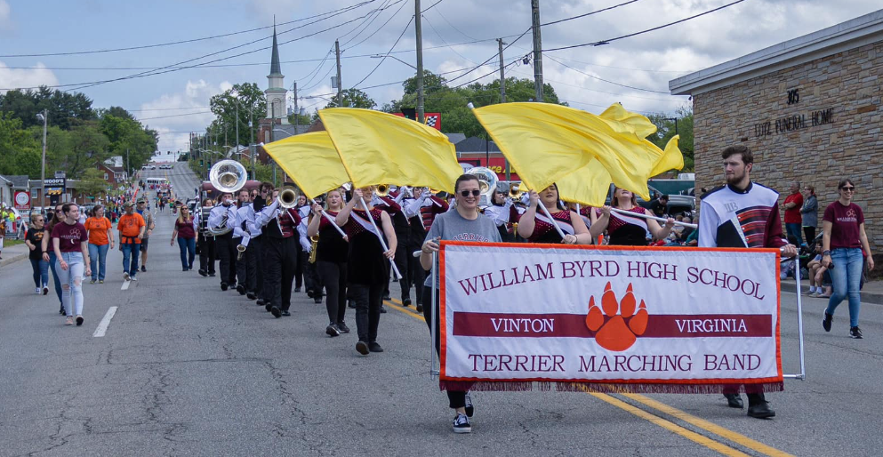
Your Responsibilities Include:
Competitions
Practices
Make sure your student is at muster on time. Support as needed (props, equipment, water)
Monday, Tuesday and Thursday each week from 3:40-6:00pm
Game Nights
Parades
Help with equipment staging and tear down. Monitor the area while students are performing
Christmas and Dogwood Parades in Vinton, Veterans Day Parade in Downtown Roanoke
Band is a TEAM sport! Every member is an important part of the team!

Slide 4
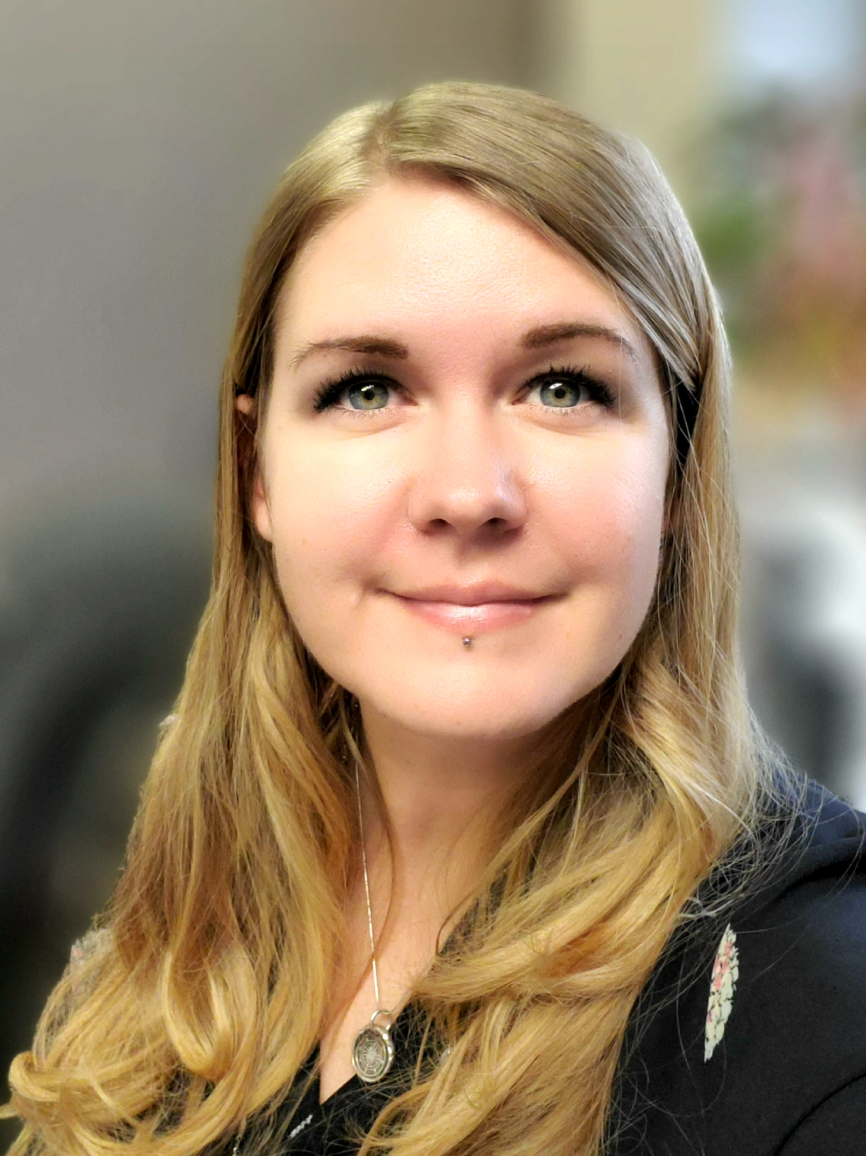

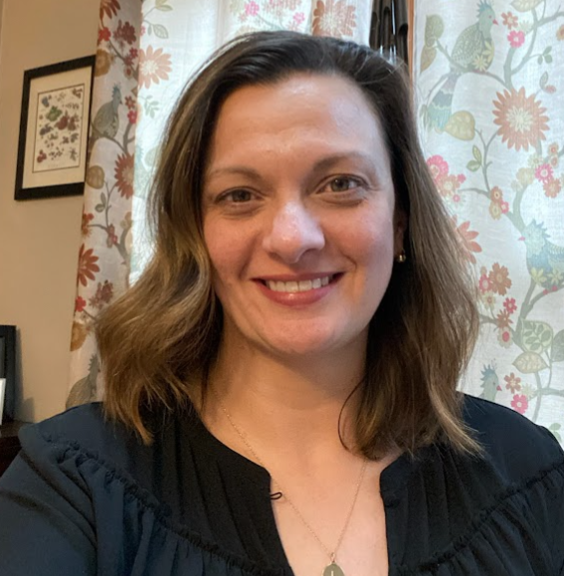
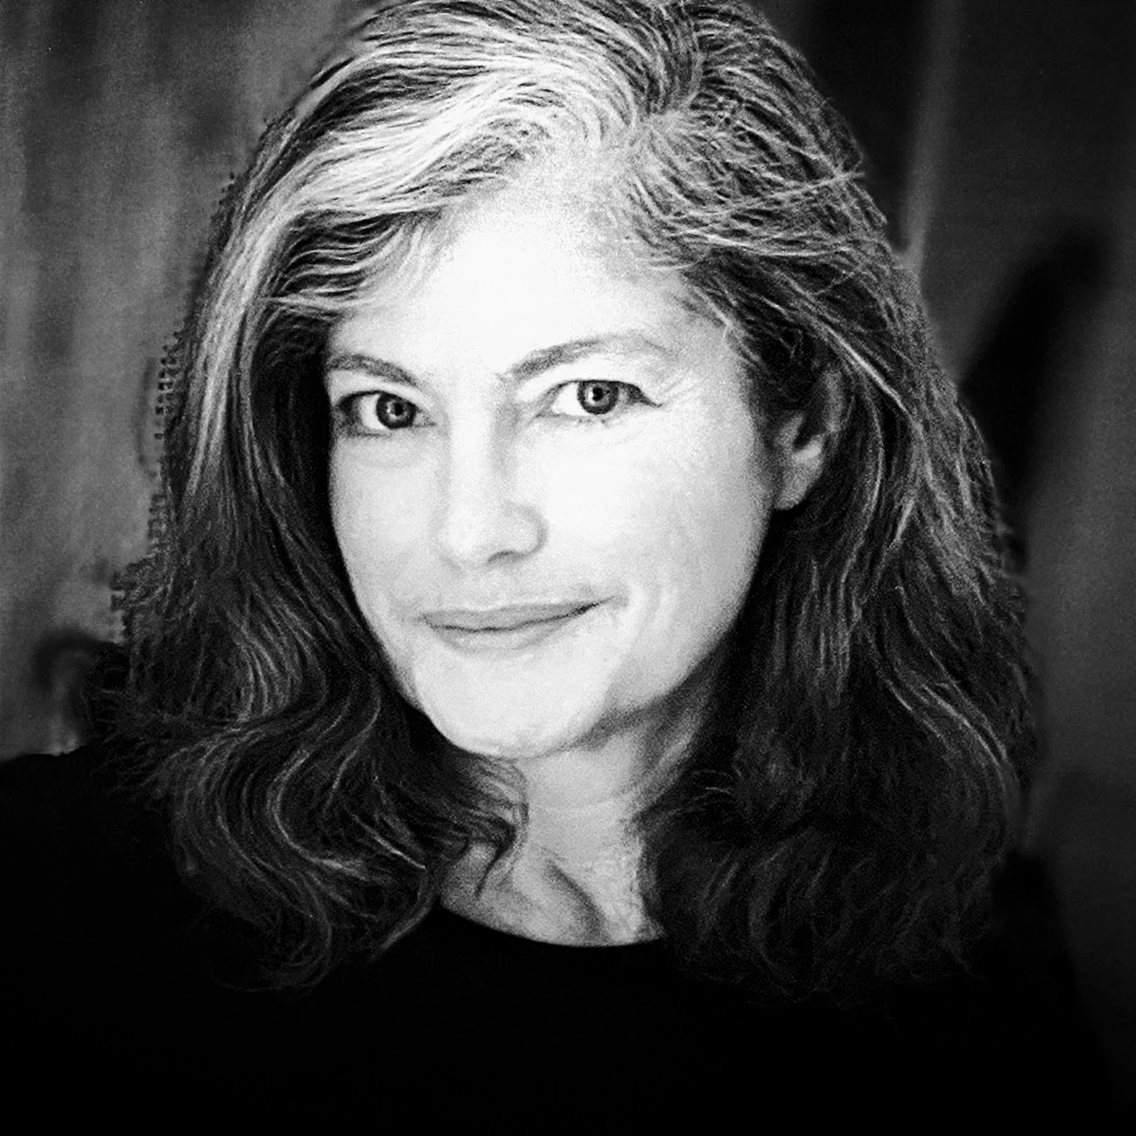
Band Booster Leadership Team
President
VP
Secretary
Treasurer
DeAnna
Schuler
Joe Eline
“Ace”
Lori
Geist
Beth
Williams
Ways &
Means
Webmaster & Digital Media
Comms
Volunteer Coordinator
Jeanne
Morrison
Rafe
Telsch
Heidi
Schmidt
Kristi
Telsch

Slide 5








Stay Connected!
Band Webpage
Real-time social media. Currently the most popular. No character limit.
Schedules, Forms, Packing Lists, Photos, Parent Info, Music, & much more
Notes:
Regular emails will be sent during band season to both your student’s school email address and the parent/guardian email address(es) provided in your ANVER forms at the beginning of the school year.
We also communicate on the platforms below.

Slide 6



Fees
Fees for the season are $300
  $150 Commitment Fee
  This fee covers uniform cleaning and start-of-camp expenses.
  Payment Due May 22nd
  Payments may be made via cash, check, or Roanoke County School Cash Online*
  $150 Camp Payment
  This fee covers the remainder of camp expenses, show shirts, & incidentals throughout the season.
  Payment Due July 21st
  Checks should be made out to WBHS
Be Aware: There is a $12.10 processing fee to use roanokecounty.schoolcashonline.com

Slide 7


Away Camp
Scholarship Application
Everyone deserves the chance to go to camp.
At camp, students can
Improve interpersonal skills & form close friendships
Take safe risks and tackle new challenges
Experience character growth & develop life skills
Meet positive role models
Discover their best self
Please don’t let the cost of Away Camp prevent your student from participating. Scan the code or ask a Board member how to apply for an Away Camp Scholarship.

Slide 8

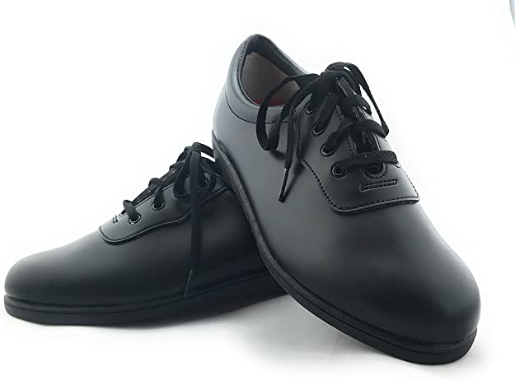
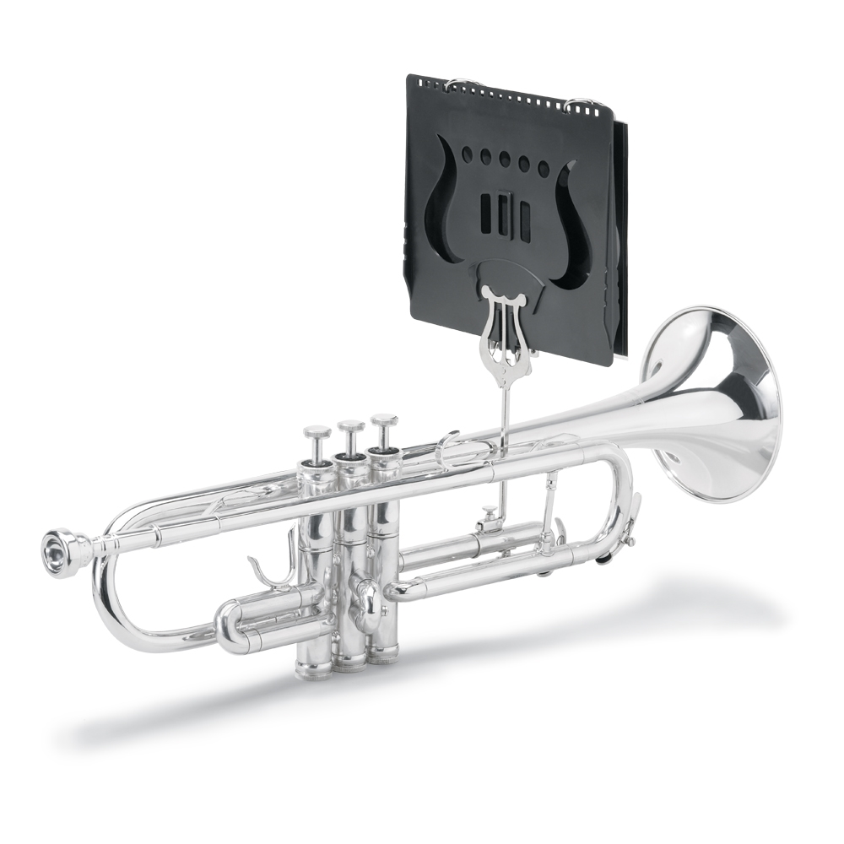
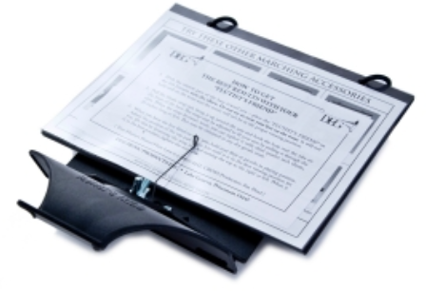

Additional Costs
Band
Instrument
White Marching Gloves (excludes drumline & front ensemble)
Matte Black Marching Shoes
Flipbook and lyre
Guard
Shoes
Uniforms
Warmups – more to come about this from our Guard Instructor

Slide 9





IMPORTANT DATES
ALL of these camps will be held at WBHS
JULY
JULY
JULY
14-18
16-17
21-25
Percussion Camp &
Color Guard Camp
9am - 1pm
**BRING A LUNCH**
Rookie Camp
(ALL First-Year Members)
9am – 11am
Home Camp
(ALL Members)
8am – 4pm
**BRING A LUNCH**
Scan here add the WBHS Band calendar for
Google or IOS!

Slide 10



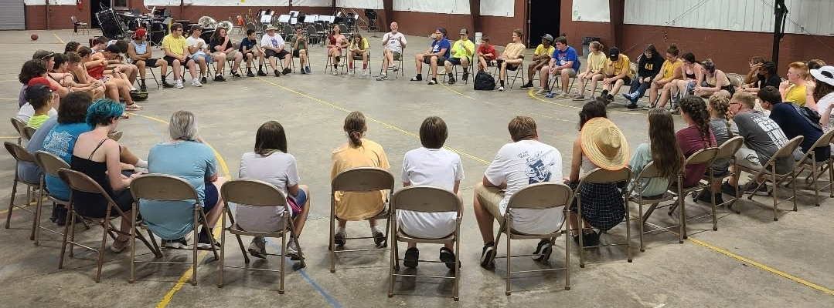
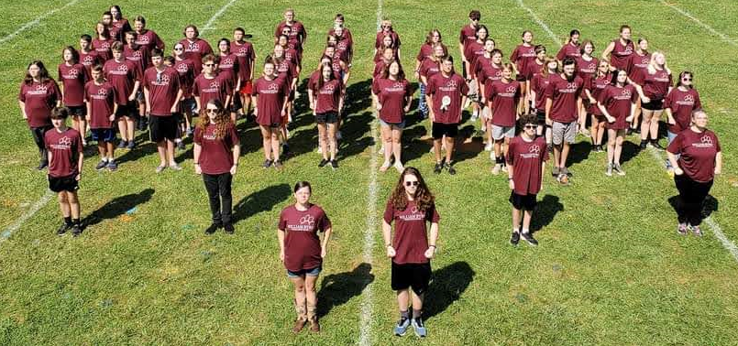
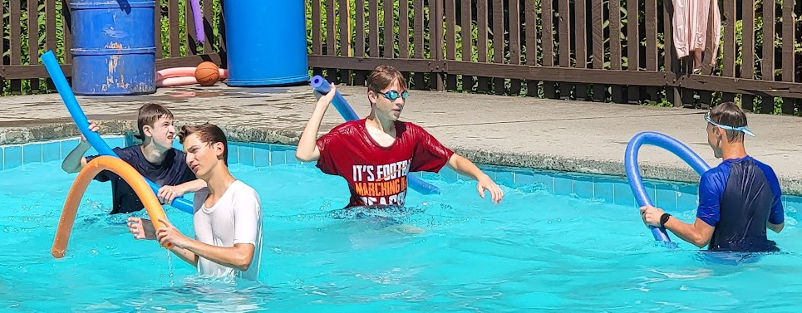
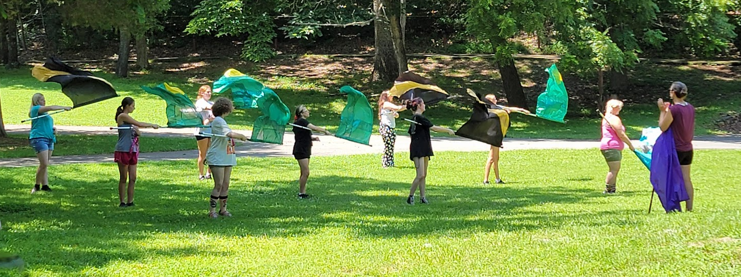
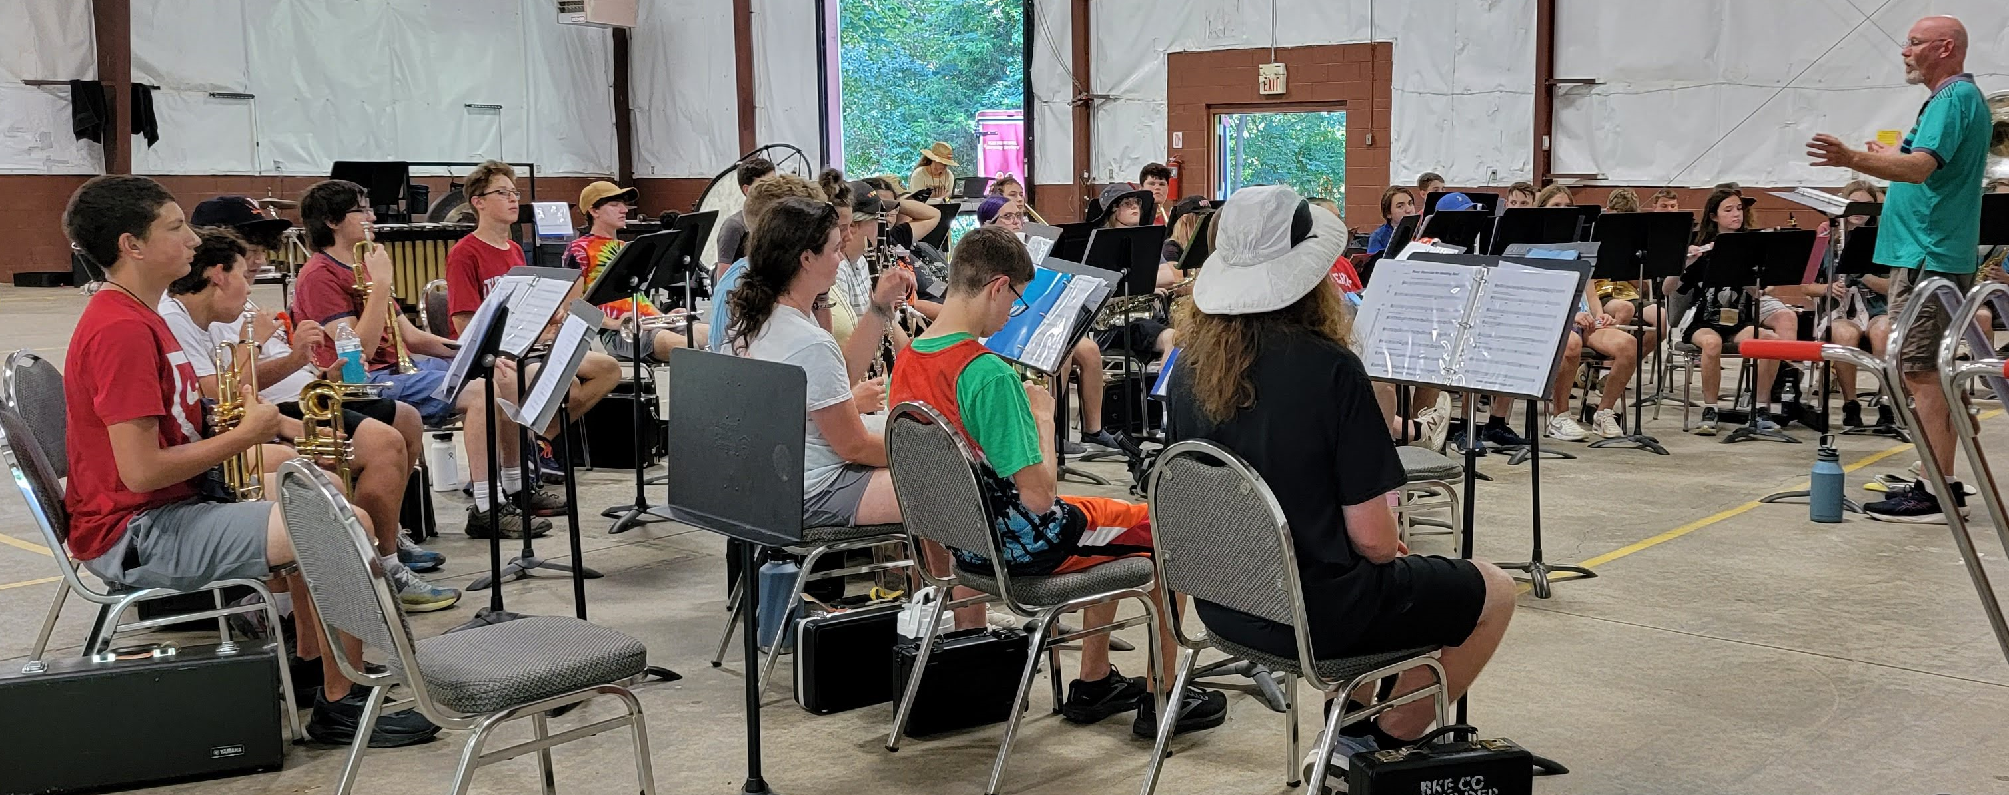
AWAY Camp
JULY
AUGUST
27
2
COST: $300
Final payment, permission slips, and health forms due by July 21^{st.}
Depart:
We leave WBHS for camp at 2:00 pm on Sunday.
Pick Up:
Your student must be picked up from Camp Bethel at noon on Saturday, August 2nd.
*If you need assistance with camp fees, please see a board member for a scholarship application.
A special pre-season performance of our 2025 show will be held for parents before the first home game.

Slide 11



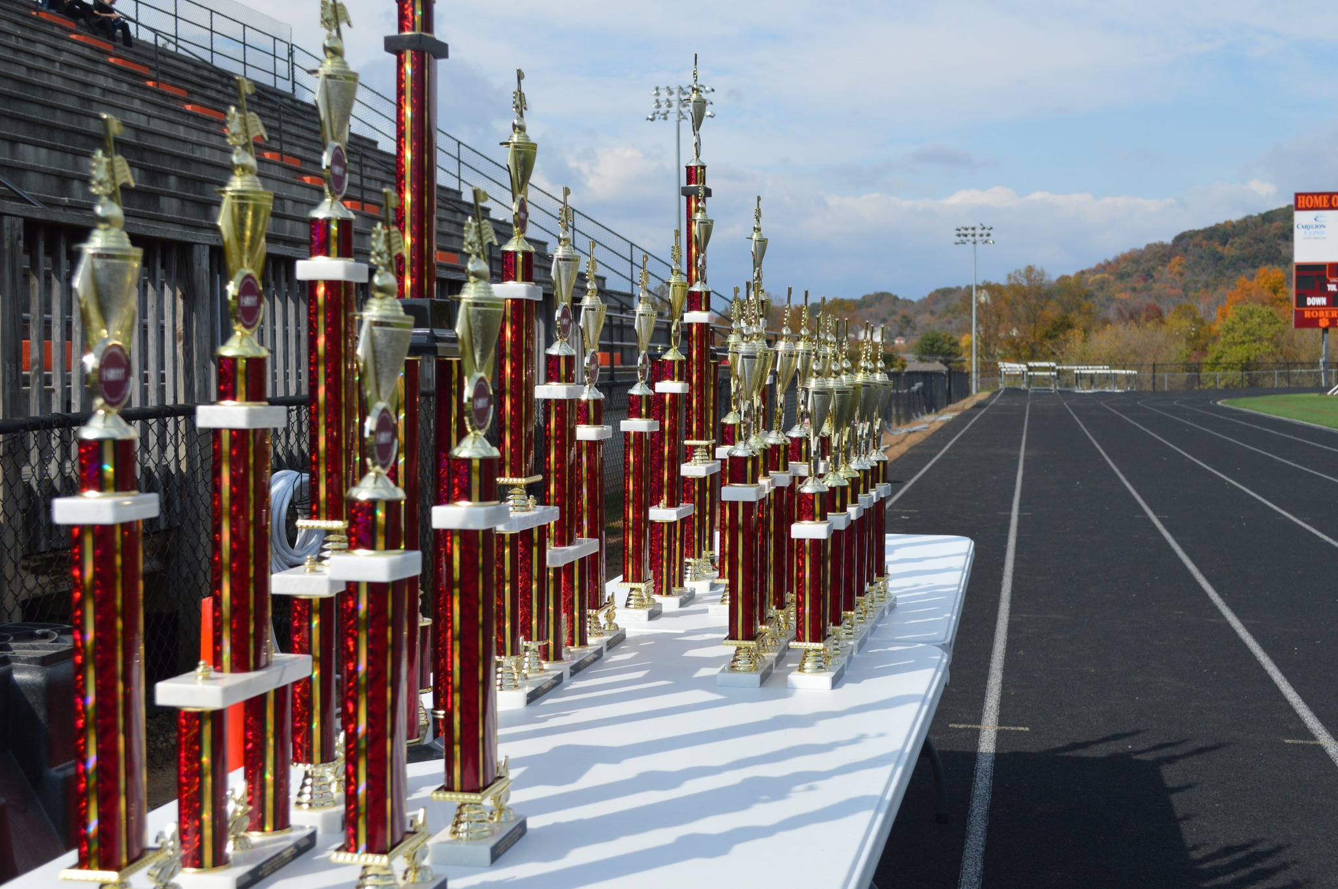
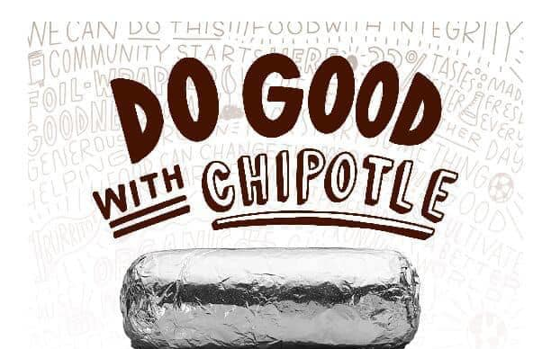
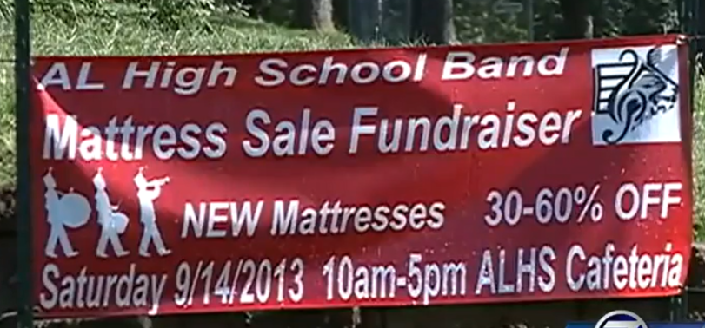
Fundraisers…
We have several major fundraisers throughout the year.
Jazz Café
Jazz & BBQ
Donation Platform
Blue Ridge Festival of Bands
This drive takes place during Home Camp.
Spring events featuring our Middle & High School Jazz Bands.
Hosted by WBHS. Band Members & Boosters run the show!
Additional fundraisers like a Dine-2-Donate at a local restaurant may also be held throughout the year. Recommendations are welcome! More info to come on this as we get started with band season.
Notes:
Cue Dan to talk about SnapRaise and hand out forms to anyone who didn’t get one on the way in!

Slide 12


Band Competition
Our largest fundraiser is the Blue Ridge Festival of Bands
All hands on deck!
This show can only be successful with your support.
Jobs Include:
Sponsorship Sales
Ticket Sales
Equipment load/unload
Visiting band support
Concessions
Scorekeeping
Announcing & More!
OCTOBER 25TH
If you or someone you know has a trailer or ATV that could be available to transport equipment on & off the field, let a board member know!
Notes:
Last year, the band earned over $20K in sponsorships, ticket sales, and concessions.

Slide 13




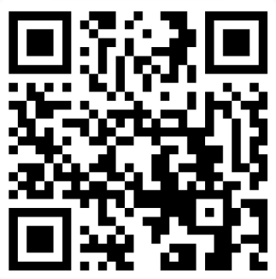
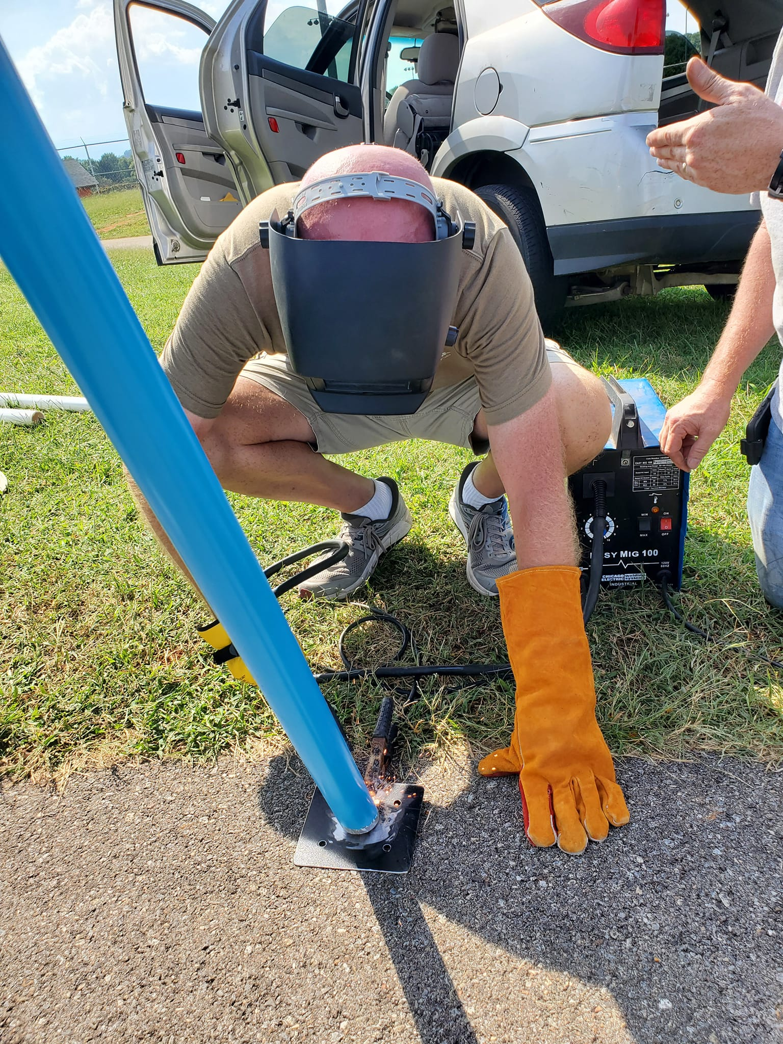
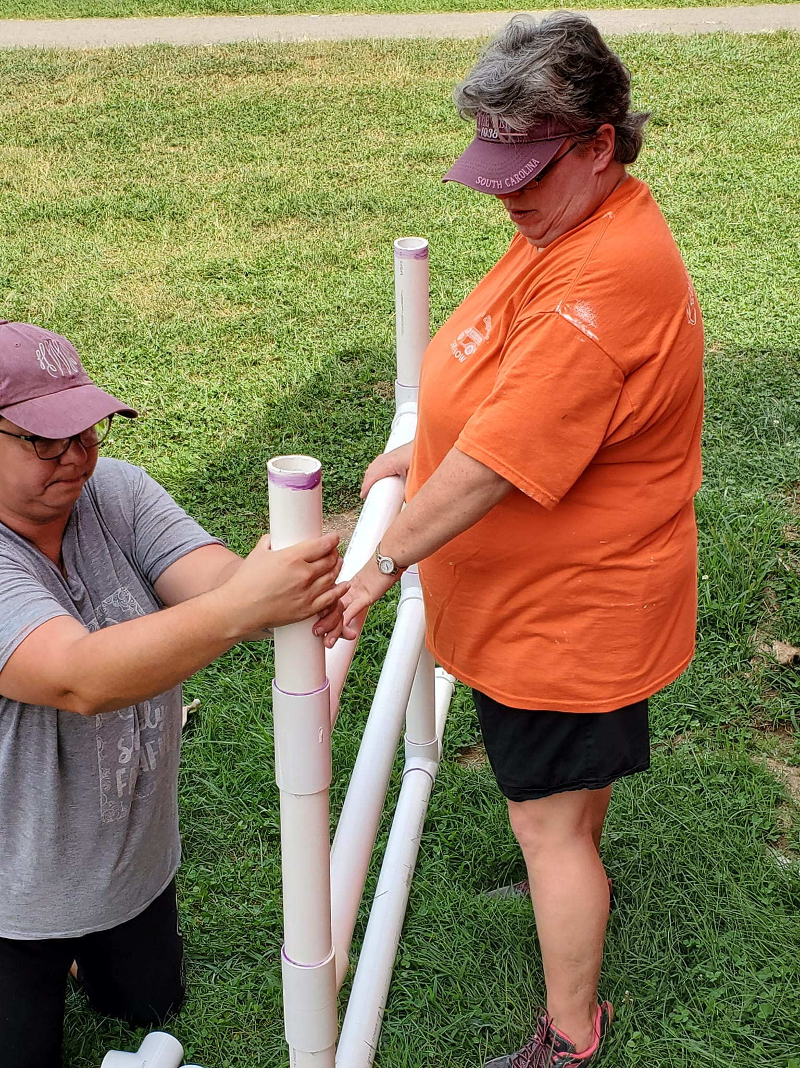
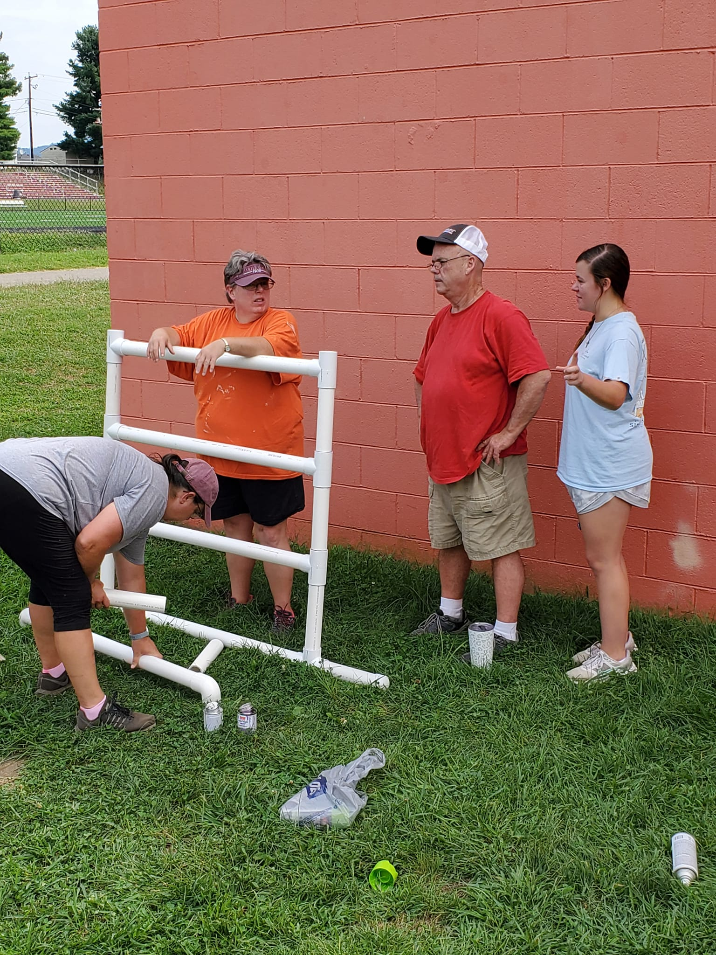
What we need from you…
Commitment Form
Health Form
Time – We’re always looking for volunteers!
$150 Deposit
We want to hear from you! Use our volunteer form to let us know how you’d like to help!

Slide 14
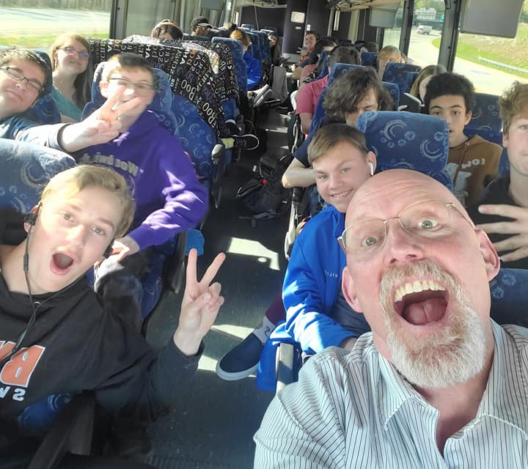
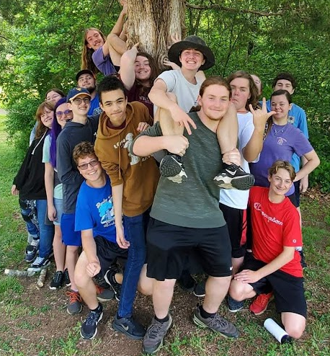
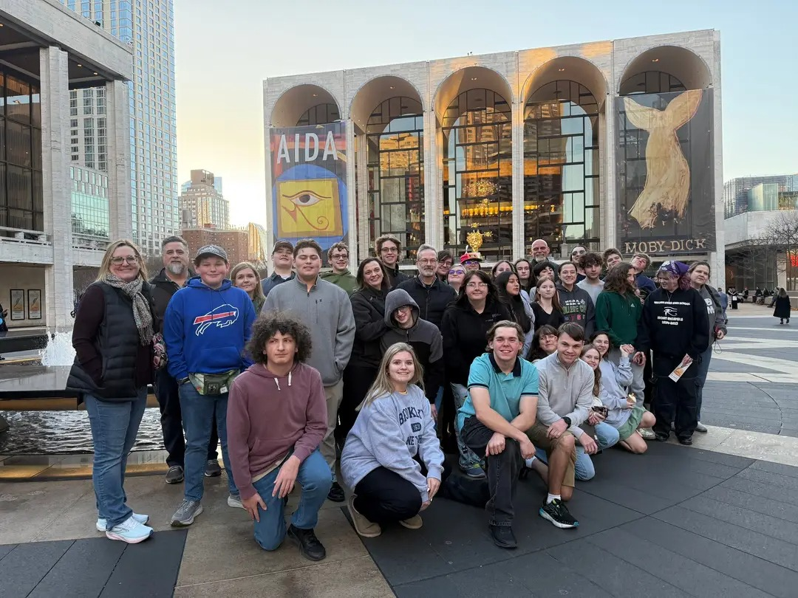
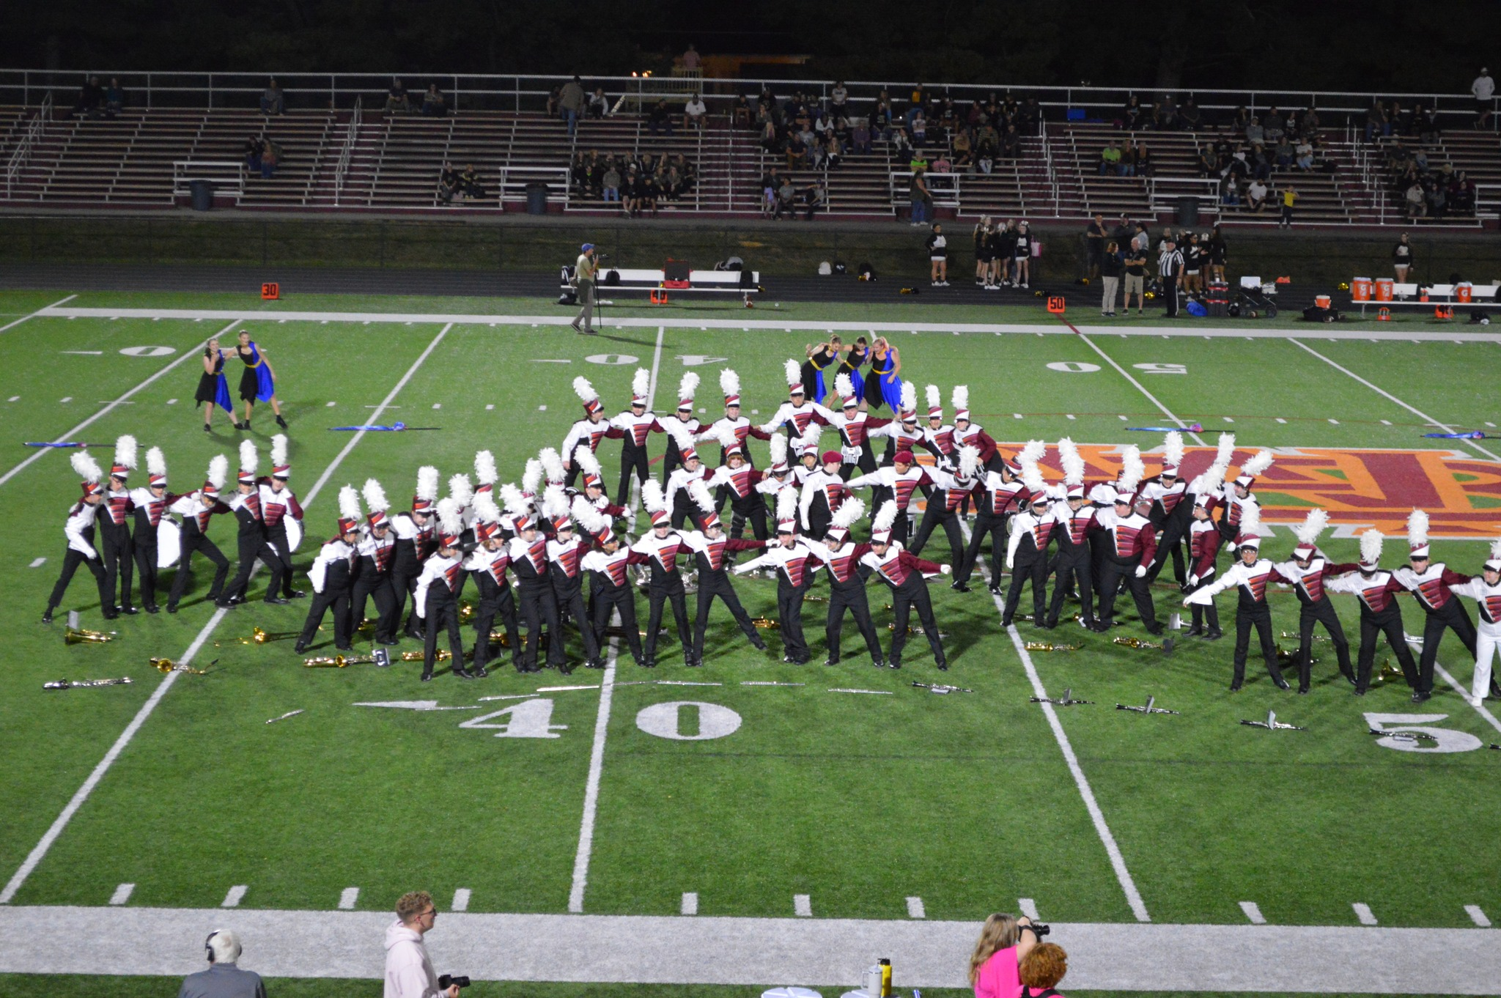
Welcome to the Band Family!

